Slide 1
Service integration to improve outcomes: Opportunities and challenges
JAMES AYIEKO MBChB, MPH, PhD
Kenya Medical Research Institute, Kenya

Slide 2
No conflict of interest to declare

Slide 3
Integrated HIV Care: delivery of care services for more than one condition at the same point of care
Integrated HIV care:
      a) can motivate persons to get care (and testing)
      b) potentially improve outcomes for patients in care
      c) provide efficiencies for the health care system
PATIENT AND PROVIDER PERSPECTIVES
PATIENT/CLIENT-integration means health care that is seamless, smooth and easy to navigate.
  It minimizes:
        a) the number of stages in an appointment
        b)the number of separate visits to a clinic.
  They also want health workers to be aware of their health as a whole (not just one clinical aspect).
PROVIDERS-integration means that separate technical services are provided, managed and evaluated either together, or in a closely co-ordinated manner.
WHO 2008

Slide 4
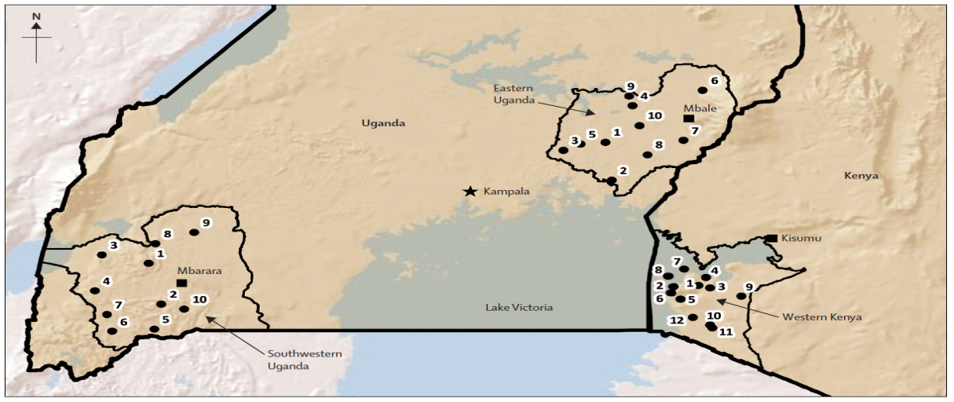

SEARCH Test and Treat trial: A multi-disease approach
Uganda East
N=10
Uganda West
N=10
Kenya
N=12
A large HIV test and treat trial conducted in rural Uganda and Kenya involving 32 communities comprising approximately 10,000 individuals per community.
Employed a multi-disease health fair approach for screening of HIV, HTN, Diabetes, Cervical cancer, while offering treatment for common ailments
Those with disease were linked to care and continued to receive care using an integrated model
Approach: Personalized, integrated and streamlined patient-friendly service

Slide 5

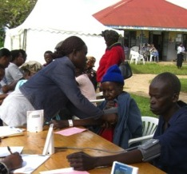
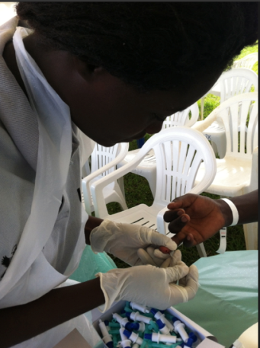
Integration of Hypertension in screening and treatment
Screening
Treatment in clinic
Linkage
Marginal cost of integrated hypertension and diabetes screening: $1.16
Chang et al, JAIDS 2017
Notes:
How did we integrate htn screening and treatment, how was it done, how much did it cost on top of routine testing?
https://www.ncbi.nlm.nih.gov/pmc/articles/PMC5089839/

Slide 6
Characteristics of individuals screened for Hypertension
(n = 65,544)
Male | 41%
Age (years)
18-29 | 39%
30-44 | 31%
45-59 | 18%
>= 60 | 12%
BMI >= 25 (overweight or obese) | 17%
Diabetes | 1%
HIV+ | 5%
Hypertension | 14%
Stage 1 Hypertension | 34%
Stage 2 Hypertension | 66%
Hypertension prevalence among general population was 14% and 11% among those living with HIV
Kwarisiima et al, PLOS One 2016
Notes:
What were the characteristics of those who had hypertension

Slide 7
Improved Hypertension control at Population-level in communities with integrated HIV/NCD clinics
RR: 1.16
(95%CI: 0.99, 1.36)
p=0.07
Population-level HTN control at year 3 was 26% higher in intervention vs. control arm (p<0.001)
HTN-HIV dual control higher in intervention vs. control (p=0.002)
RR: 1.23
(95%CI: 1.10, 1.40)
p=0.002
RR: 1.26
(95%CI: 1.15, 1.39)
p<0.001
Among baseline stable residents aged >30 years, N=59,218 with HTN measured at FUY3; adjusted for missing measures of HTN control; *also adjusted for unknown HTN status.
Notes:
Say verbally that similar results with diabetes

Slide 8
Hypertension control increased among those receiving care in integrated HIV/NCD clinics at low marginal cost
“…ever since I joined SEARCH intervention I have never queued when I go for my clinic…..you spend very little time at the facility …”
SEARCH study Participant
Added cost of hypertension care to existing HIV care:
  HIV+ : $6.29/person/year (2% marginal increase)
  HIV-: $11.39/person/year (4% marginal increase)
Kwarisiima et al, BMC Public Health 2019; Shade S et al, Submitted (under review)
Notes:
From Starley/Vivek paper:
Overall Costs of Hypertension Care Delivery. For HIV-positive individuals, provision of HTN care added an average of $6.29 per person per year to the baseline costs of streamlined HIV care (Table 3). We previously reported costs of HIV streamlined care delivery as an average $291 per person per year;^{[33]} thus, an $6.29 increase represented a 2.1% marginal increase in total costs of care for adding HTN services. For HIV-negative individuals, the cost of adding HTN care into the chronic general medical care offered at clinics was $11.39 per person per year, representing a 3.8% marginal increase in cost (Table 3).

Slide 9
Summary and conclusion
Integrated care services can lead to improvements in NCD and HIV outcomes at the population level and within clinics
Integration of NCD screening and care is associated with low marginal costs
Integrated care services is associated with high satisfaction among patients and providers
Commitment on part of leadership (Ministries of health, implementing partner programs) is key for successful integrated care services.
Successful and sustainable integrated care services at lower level health facilities depends on uninterrupted supply chain (medications, testing kits, etc.)
“We need a comprehensive, integrated approach to service delivery. We need to fight fragmentation.” WHO Director-General, 2007

Slide 10












Acknowledgement and Thank you!
All study participants
Diane Havlir, MD, UCSF, Principal Investigator
Moses Kamya, MD, PhD, Makerere University, Co-Principal Investigator
Maya Petersen, MD, PhD, UC Berkeley, Co-Principal Investigator
http://www.searchendaids.com/
Vice-Chair: Edwin Charlebois
Statistician : Laura Balzer
Virologist: Teri Liegler
MU-UCSF-IDRC Dalsone Kwarisiima
KEMRI:Elizabeth Bukusi, James Ayieko, Norton Sang
KEMRI:/UCSF: Craig Cohen
UCSF: Tamara Clark, Gabe Chamie, Vivek Jain, Carol Camlin, Starley Shade, Ted Ruel

